Slide 1
Where to find materials
for the
Solar Car Project
Joel Pitts
Greenville High School

Slide 2
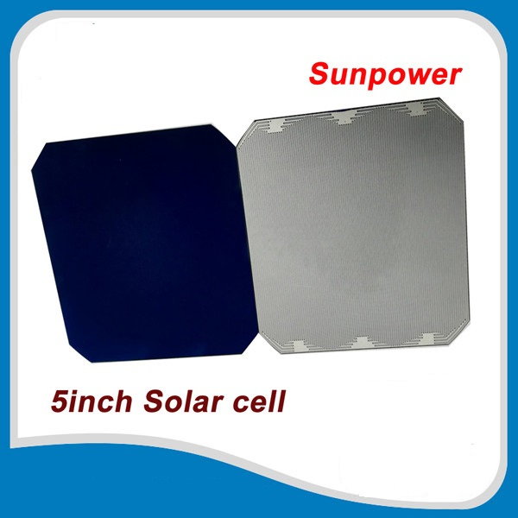
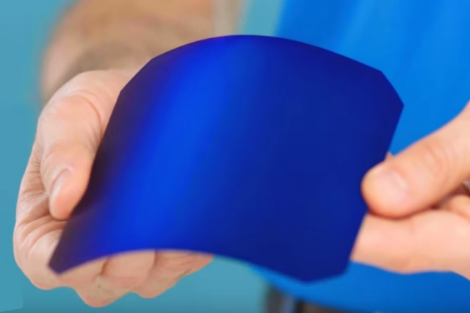
Solar Panels & Cells
Wholesale Solar - www.wholesalesolar.com
SBM Solar - www.sbmsolar.com
Civic Solar - www.civicsolar.com
SunPower – Gen II (22.5% efficient), or Gen III (23.9% efficient) cells
https://https://us.sunpower.com/buy-solar-cells

Slide 3
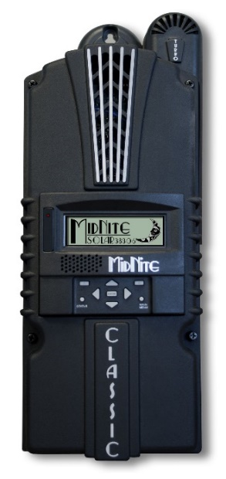
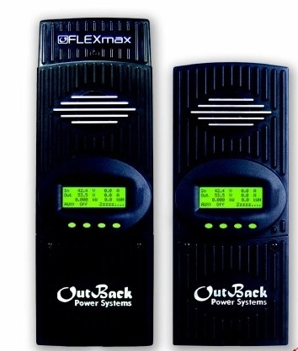
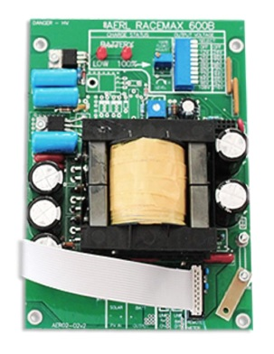
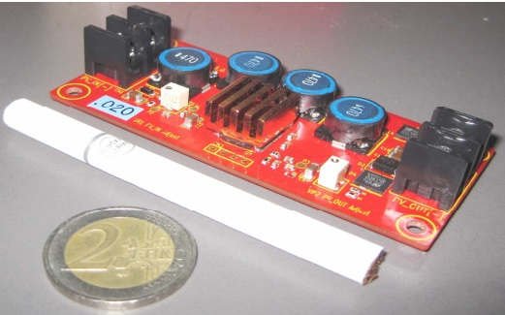
Multi Point Power Tracker
(aka: MPPT, Power Tracker, Charge Controller)
POWER TRACKERS
Wholesale Solar - www.wholesalesolar.com
MidNite Solar - www.midnitesolar.com
AERL - https://www.aerl.com.au/
Genasun – https://genasun.com
Outback Power - http://www.outbackpower.com
Nomura Co - https://www.facebook.com/NomuraCo

Slide 4
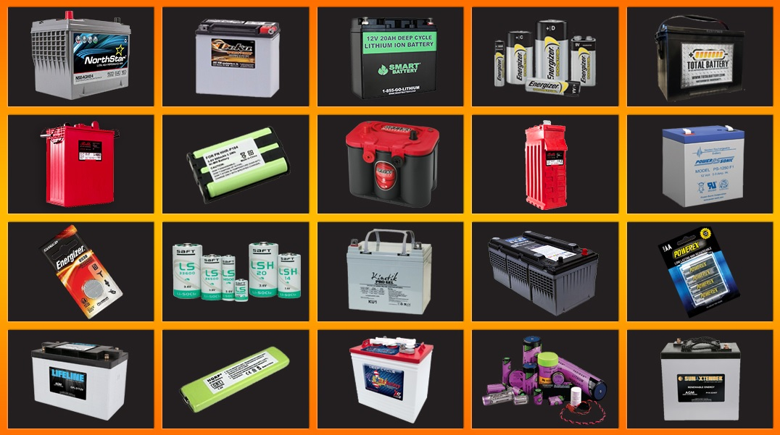
Batteries
Battery Guys- https://batteryguys.com/
Sun Xtender - www.sunxtender.com
Battery Space - www.batteryspace.com [turn-key lithium battery systems]
PowerSonic – www.powersonic.com
DC Battery – www.dcbattery.com
Wholesale Solar – www.wholesalesolar.com

Slide 5
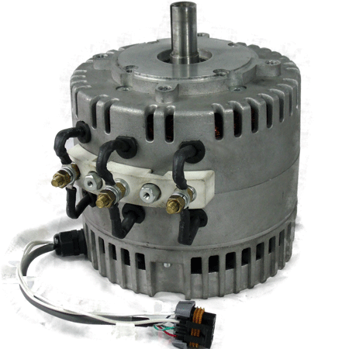
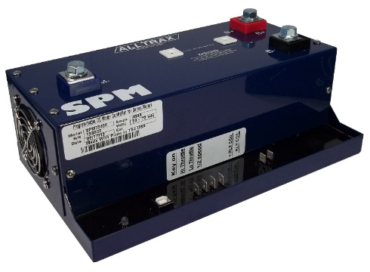
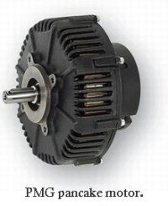
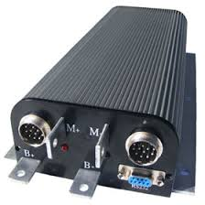
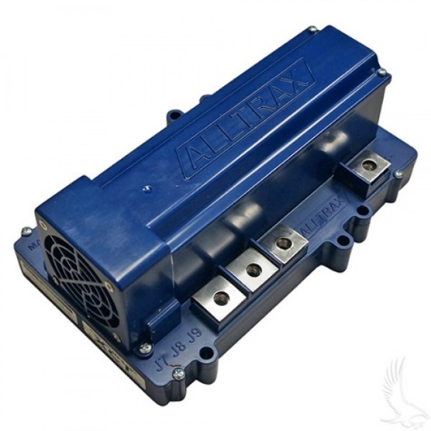
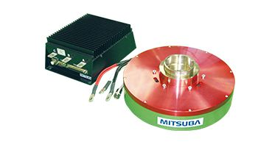
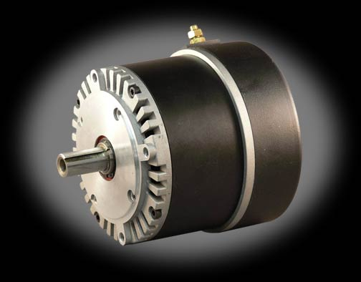
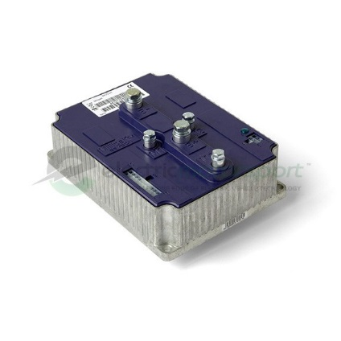
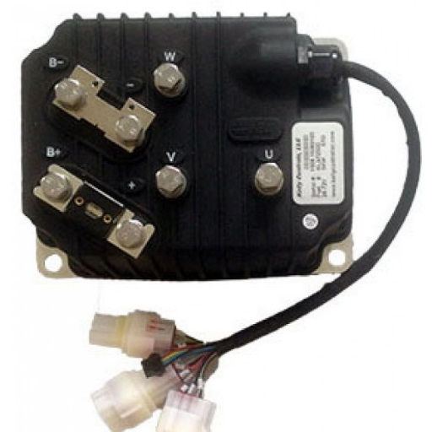
Motors and Controllers
Cloud Electric – http://www.cloudelectric.com
Electric Motorsport - http://www.electricmotorsport.com/
EV Drives – http://www.evdrives.com
Thunderstruck Motors - http://www.thunderstruck-ev.com/
Mitsuba Motors - http://www.mitsuba.co.jp/english/products/solarcarandev

Slide 6
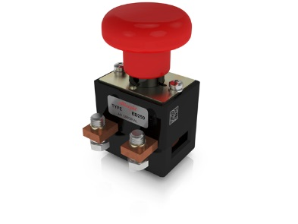
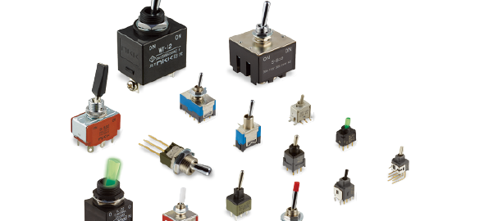
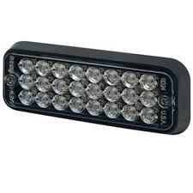
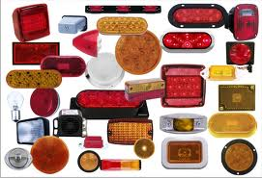
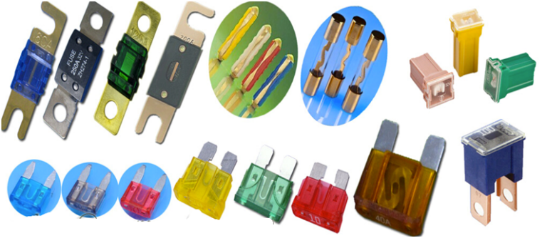
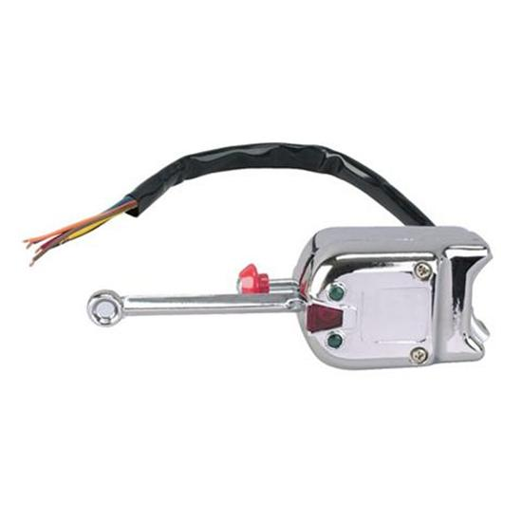
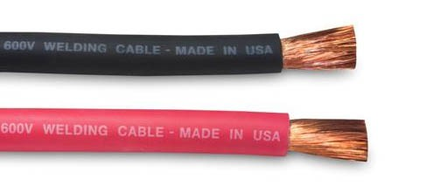
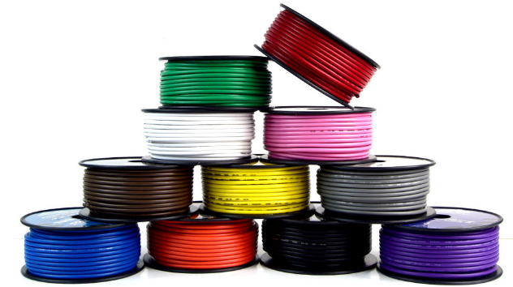
Switches, Disconnects, Lights, Fuses & Wire
SWITCHES / DISCONNECTS
For motor/array disconnects, most teams use Albright International ED250 (up to 48V) or ED250B (up to 96V).
Tecknowledgey - www.tecknowledgey.com
Electric Motorsport – www.electricmotorsport.com
Mouser Electronics – www.mouser.com
DigiKey – www.digikey.com
EV Drives – http://www.evdrives.com
Kimball Midwest - www.kimballmidwest.com
BRAKE LIGHTS & TURN SIGNALS
O’Reilly Auto Parts - www.oreilyautoparts.com
Grainger - www.grainger.com [for ECCO lights]
Etrailer - www.etrailer.com
FUSES
Electric Motorsport – www.electricmotorsport.com
Mouser Electronics – www.mouser.com
DigiKey – www.digikey.com
Grainger – www.grainer.com
Waytek - www.waytekwire.com
McMaster-Carr - www.mcmaster.com
Kimball Midwest - www.kimballmidwest.com
WIRING
Cloud Electric – http://www.cloudelectric.com
Electric Motorsport - http://www.electricmotorsport.com/
EV Drives – http://www.evdrives.com

Slide 7
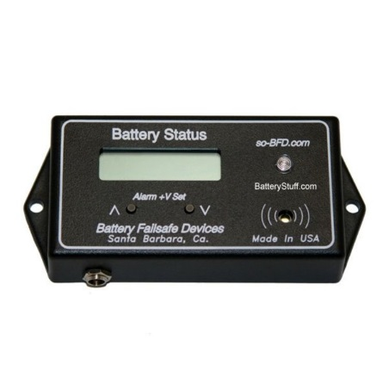
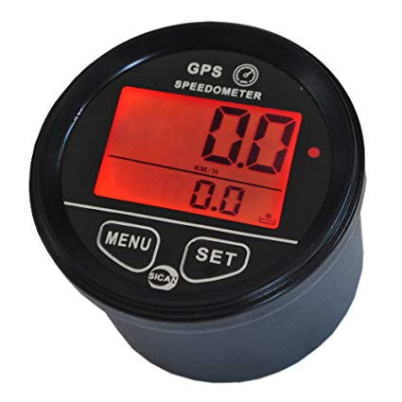
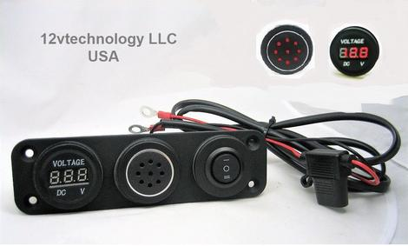
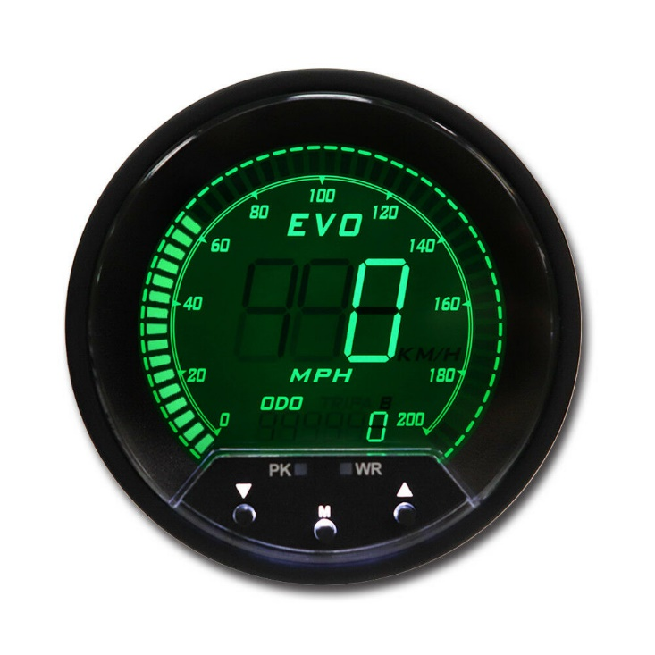
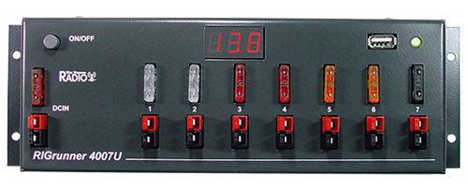
Speedometer, Low Voltage Alarm, Volt/Amp Meter
SPEEDOMETERS
GPS Speedometer – www.speedhut.com
www.ebay.com
LOW VOLTAGE ALARM [12v]
12vtechnology- https://12vtechnology.com/collections/battery-chargers-and-monitors
RIGrunner - http://www.westmountainradio.com/rigrunner.php (fuse block w/ audible alert and 3 LED lights)
Battery Stuff - www.batterystuff.com
Volt & Amp Meters
www.ebay.com

Slide 8
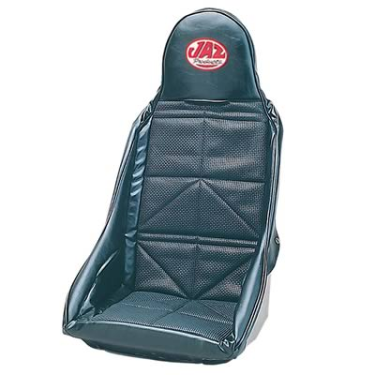
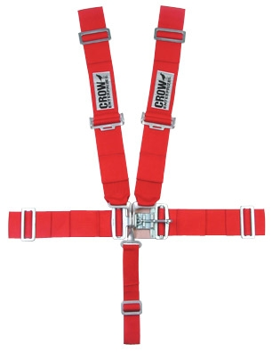
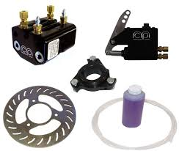
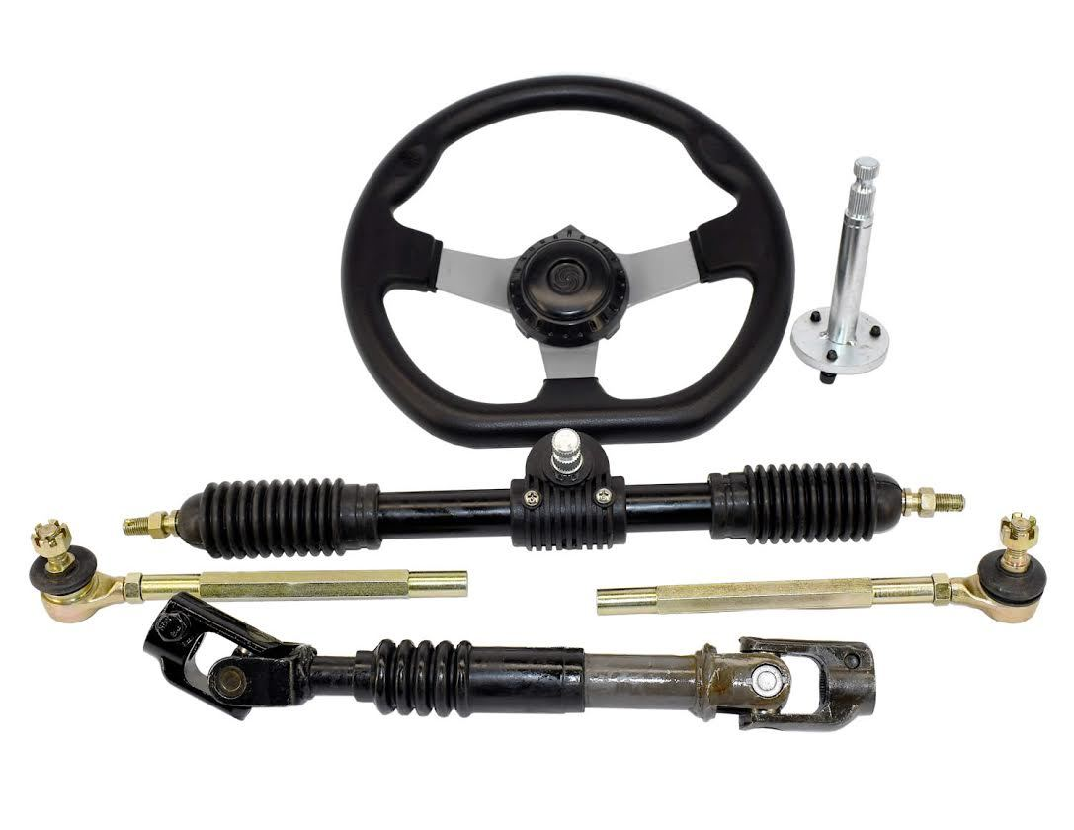
Sprockets, Seats, Seat Belts, Brakes & Steering
CUSTOM SPROCKETS
Rocket Sprockets - www.rocketsprocket.net
Rebel Gears - http://www.rebelgears.com/
Supersprox - https://www.supersproxusa.com/special-sprockets/
SEATs & Seat BELTS
Summit Racing - www.summitracing.com
Motivational Tubing - www.motivationaltubing.com
Jegs - www.jegs.com
BRAKES
Martin Custom Products - www.mcpbrake.com
Motivational Tubing - www.motivationaltubing.com
Chassis Shop - www.chassisshop.com/
Aliexpress - www.aliexpress.com
STEERING
Motivational Tubing - www.motivationaltubing.com
Chassis Shop – www.chassisshop.com
Go Power Sports - www.gopowersports.com
Aliexpress - www.aliexpress.com

Slide 9
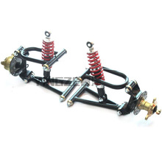
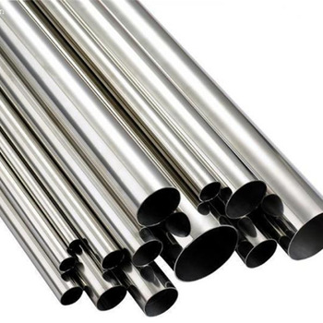
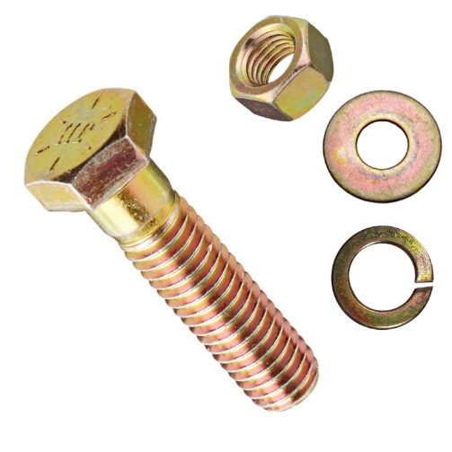
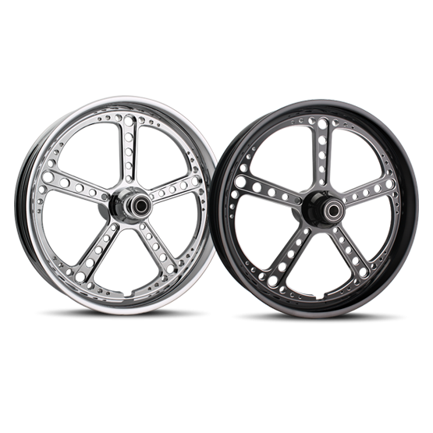
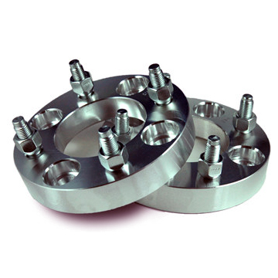
Suspension, Wheels, Metal, Nuts, Bolts, Small Parts
SUSPENSION
ATV A-arm suspension – www.ebay.com
Chassis Shop – www.chassisshop.com
FOX – www.ridefox.com
Aliexpress - www.aliexpress.com
METAL for CONSTRUCTION – [go local if possible]
Online Metals - www.onlinemetals.com
QMF Steel - www.qmfsteel.com
Garland Steel – www.garlandsteel.com
Wicks Aircraft – www.wicksaircraft.com
NUTS/BOLTS/SMALL PARTS
McMaster-Carr - www.mcmaster.com
Kimball Midwest - www.kimballmidwest.com
Bolt Depot – www.boltdepot.com
WHEELS
www.summitracing.com
www.treatland.tv
http://shop.adapterkings.com – they make adapters to go from ATV to Automotive

Slide 10
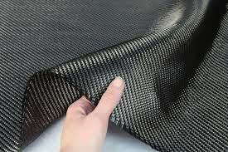
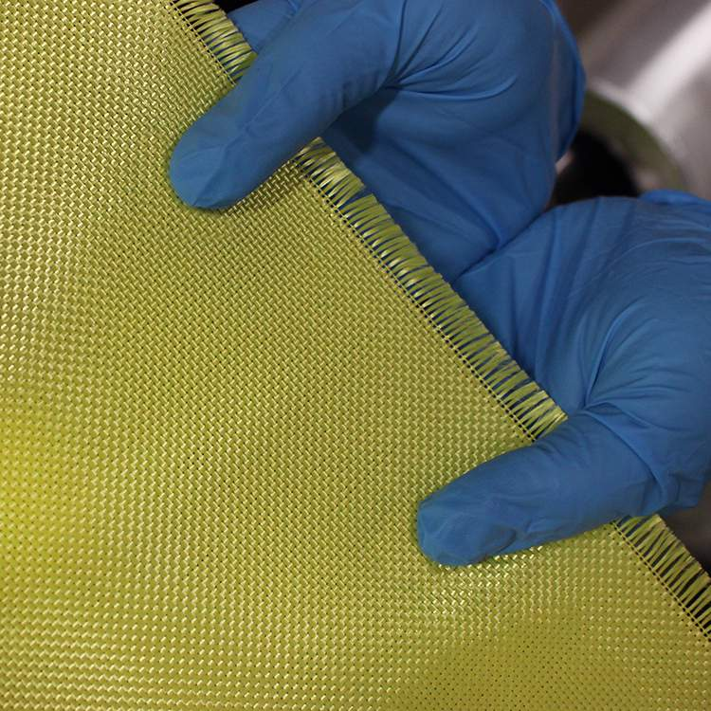
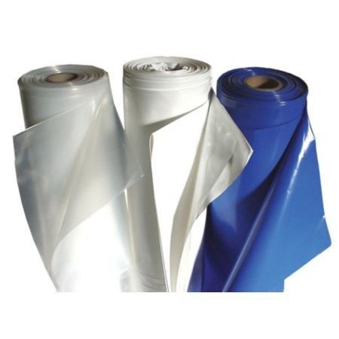
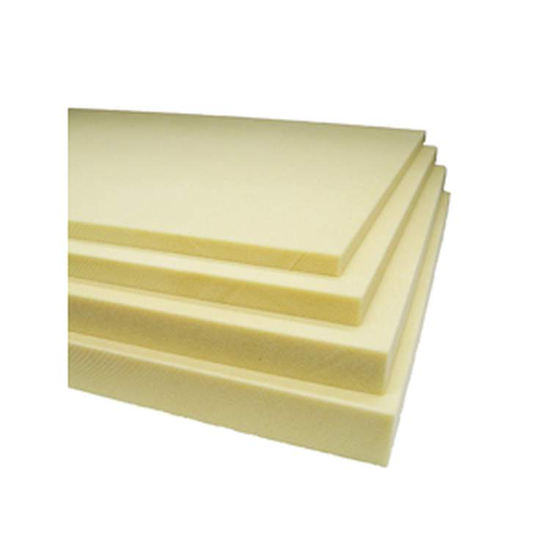
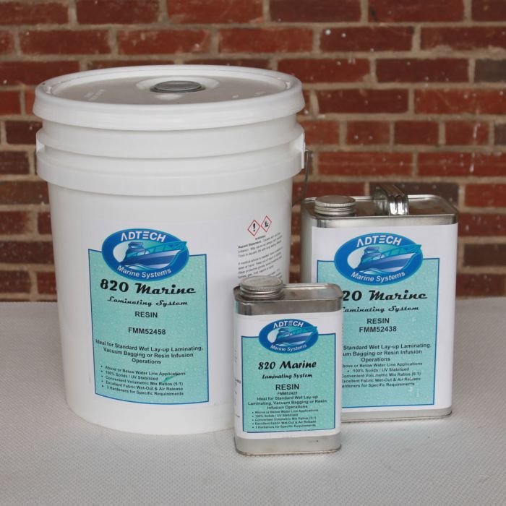
Composite Materials, Shrink Wrap, Foam
COMPOSITE MATERIALS
Express Composites - www.expresscomposites.com
SHRINK WRAP
Americover - www.americover.com
Big Shrink - http://www.bigshrink.com
POLYISOCYANURATE FOAM
Elliott Company - www.eliottfoam.com

Slide 11
One Stop Shopping

Slide 12
Ordering From China
Extended Shipping Time
Incomplete Parts
Communication Barrier
No Warranty

Slide 13
Discounts
Ask if they would be willing to sponsor the part or partially sponsor parts
Ask for Free Shipping

Slide 14
Approved Vendors
Build Relationships with Locally owned businesses

Slide 15
Questions?????

